Slide 1
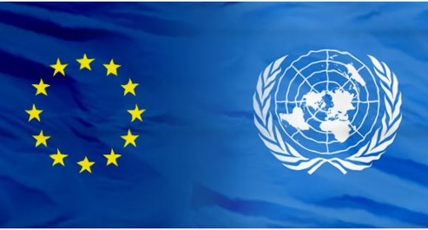
THE EUROPEAN UNION AND THE UNITED NATIONS

Slide 2
Cooperation between EU and UN
Over the years the EU has established a strong relationship with the UN. Co-operation takes place on a broad range of areas:
development,
climate change,
peace,
humanitarian assistance in crises,
fighting corruption and crime,
global health,
labour issues and culture.

Slide 3
Which projects do the EU and the UN have in common?
The EU has played an important role in developing and implementing UN Conventions and Protocols and has taken an active part in UN global conferences such as:
the World Summit on Information Society
the Kobe Disaster Reduction Conference
The Millennium Project
Notes:
I found this, but I think that this projects are not important. Use information from others students works
3

Slide 4
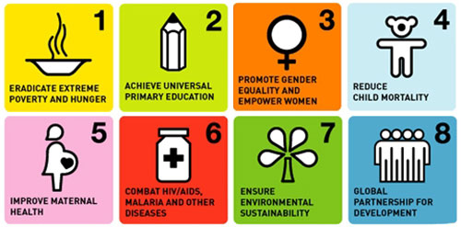
The Millenium Project
Goals:
The EU has a very important role in this project. It is the largest donor in the area of development assistance and in addition, supports the UN maintaining international peace and security.

Slide 5
What is more important about this cooperation?
We think that with this cooperation we can have:
security;
peace;
stronger economy;
The benefit to go abroad to buy and sell what we want;
A better fight against crime;
Help from UN in case of war;
A bigger development in poor countries.
Critic: The least developed countries (LDCs) are at a disadvantage against the more developed.
Some countries does’t feel the help from UN.

Slide 6
EU plan to reform UN
Security council: change the permanente membership of the UN Security Council, which reflects the power structure of the world as it was in 1945.
UN Secretariat Transparency: make the UN administration more transparent, more accountable, and more efficient, including direct elections of the Secretary-General by the people. Make more use of Asia, Africa and other so-called less developed regions that now offer a large pool of talented, skilled, and highly motivated professionals.
Democracy: the UN needs to become a “more democratic”, and a key institution of a world democracy.

